Slide 1
The Economic Impacts of the Regional Greenhouse Gas Initiative on Nine Northeast and Mid-Atlantic States
Review of RGGI’s Third Three-Year Compliance Period (2015-2017), and Results Since Inception (2009-2017)
Paul Hibbard
Energy Policy Roundtable in the PJM Footprint
May 23, 2018

Slide 2
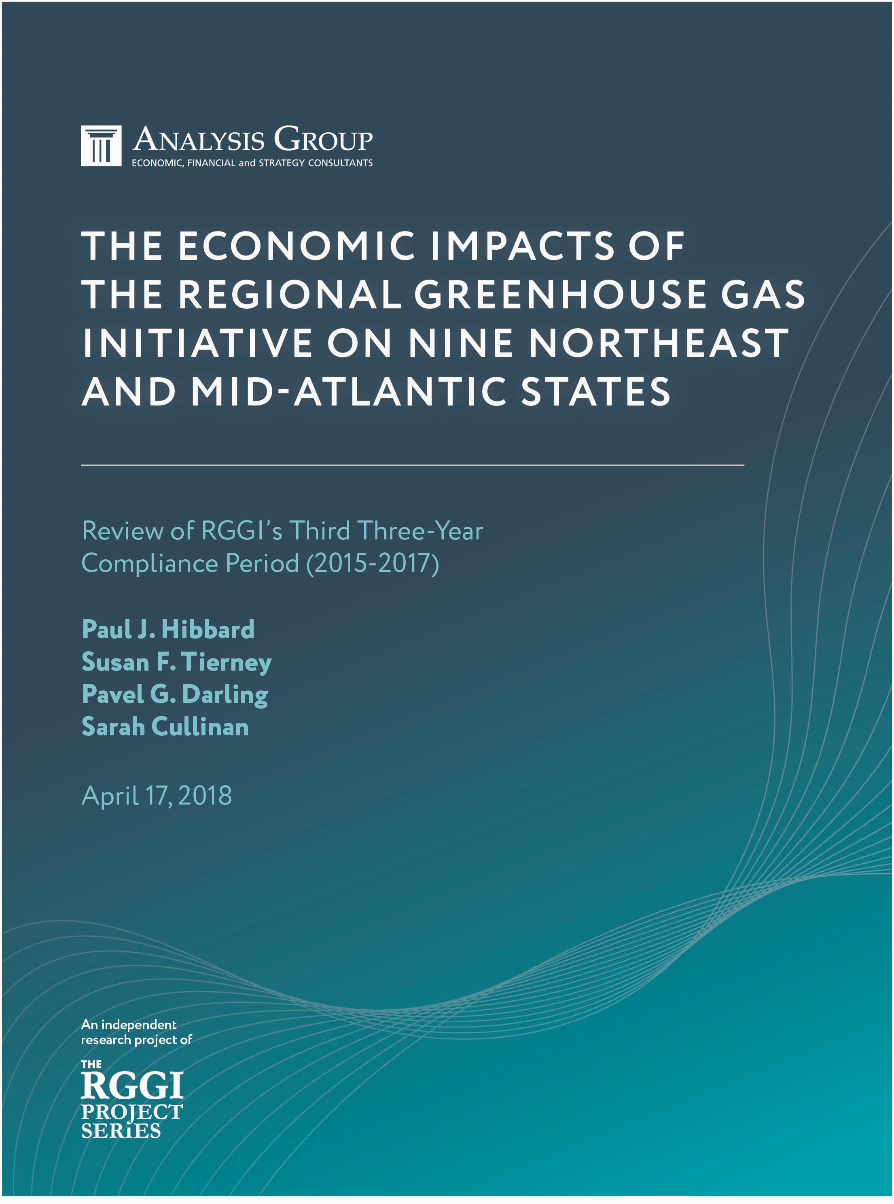
Study
Independent Power System and Economic Review
Independent analysis of Compliance Period III (2015-2017)
Methodologically Consistent with review of Compliance Periods I & II (2009-2011, 2012-2014)
Analysis Group - full analytic/editorial control
Funding
Barr Foundation
Energy Foundation
Merck Family Fund
Devonshire Foundation
Environmental Trust
Seal Bay Foundation
Betterment Fund
John Merck Fund
New York Community Trust
Technical Advisory Group
Joshua Gould, ConEdison
Carrie Jenks and Chris Van Atten, MJ Bradley & Associates
John Larsen, Rhodium Group
Paul Miller, NESCAUM
Karen Palmer, Resources for the Future
Kathleen Robertson, Exelon Corporation
Matt Stanberry, Advanced Energy Economy
Matthew Suhr and Eileen Howe, Calpine Corporation

Slide 3
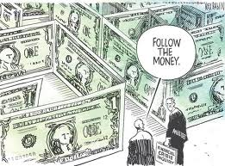
What the study is…
Study
What the study is not…
Review of health or other benefits of CO₂ reduction
Review of environmental impacts
Evaluation of need for a carbon control program
Forecast of future program participation, effectiveness, results
Assessment of appropriateness of cap level
Analysis of carbon market
Economic study
  …of actual revenues, actual programs, actual impacts
Following the money
…through the electric sector
…and through the macro economy
Measuring results

Slide 4
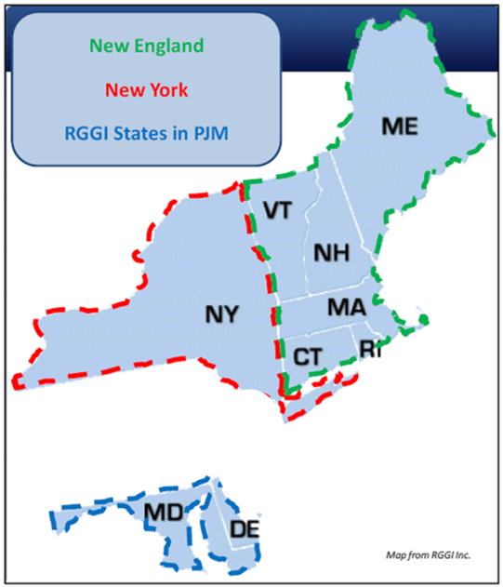
Actual CO₂ Emissions and the RGGI Cap
Over this time period, 9 RGGI states:
On the order of $4 billion in economic value added
More than 40,000 jobs added (job-years)
Source: RGGI, Inc. data from the RGGI CO2 Allowance Tracking System (COATS), accessed March 2, 2018.

Slide 5
Study Approach

Slide 6
Following the Money….
  Dollar Flows from RGGI Auction Proceeds through State Spending Impacts
$901 million over 3 years
Different states
  Different programs
  Different agencies
  Different tracking methods
  Different assumptions
Impacts (+ and -) in electric sector and larger economy
Impacts in electric sector and larger economy

Slide 7
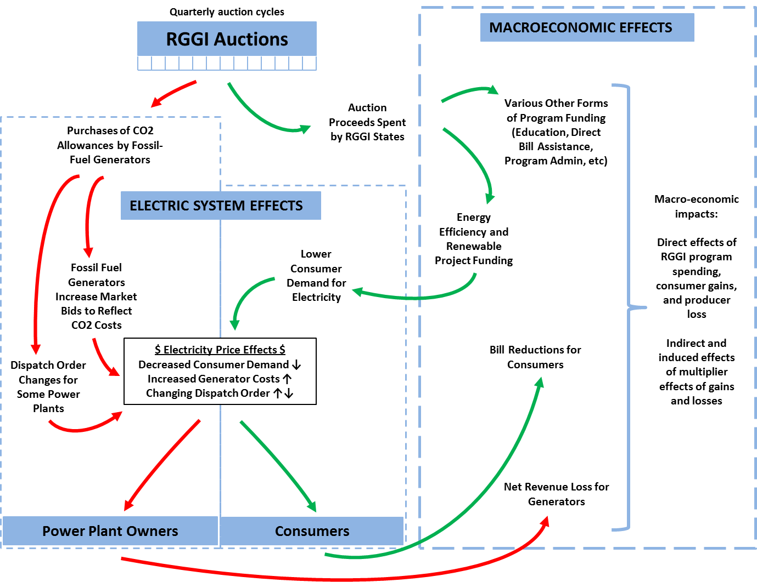
Power System and Macroeconomic Models
IMPLAN
PROMOD

Slide 8
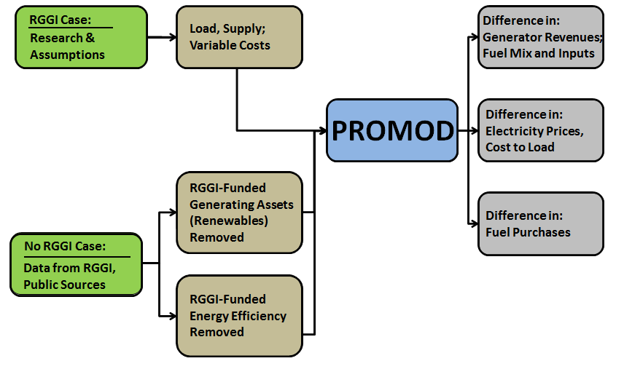
PROMOD Inputs and Outputs

Slide 9
Allowance Sale Revenues, Use of Proceeds

Slide 10
Auction Proceeds by State by Compliance Period
Compliance Period I
Compliance Period II
Compliance Period III
Notes: [1] Figures include Auctions 1-38. Auction proceeds from Auctions 1 and 2 (occurring in 2008) are included in 2009. All other values are expressed in nominal dollars in the year the auction proceeds were generated. [2] Figures do not include fixed-price sales proceeds. Source: RGGI, Inc.

Slide 11
RGGI Auction Allowances and Clearing Prices
Notes:
[1] Clearing prices are weighted averages, based on number of allowances sold.
[2] In 2014 and 2015, the Cost Containment Reserve (“CCR”) trigger price was exceeded and additional allowances above what were originally offered into the market were ultimately presented and sold to market participants. In 2014 and 2015, 5 million and 10 million additional allowances were sold, respectively.
Source: RGGI, Inc., http://www.rggi.org/market/co2_auctions/results.

Slide 12
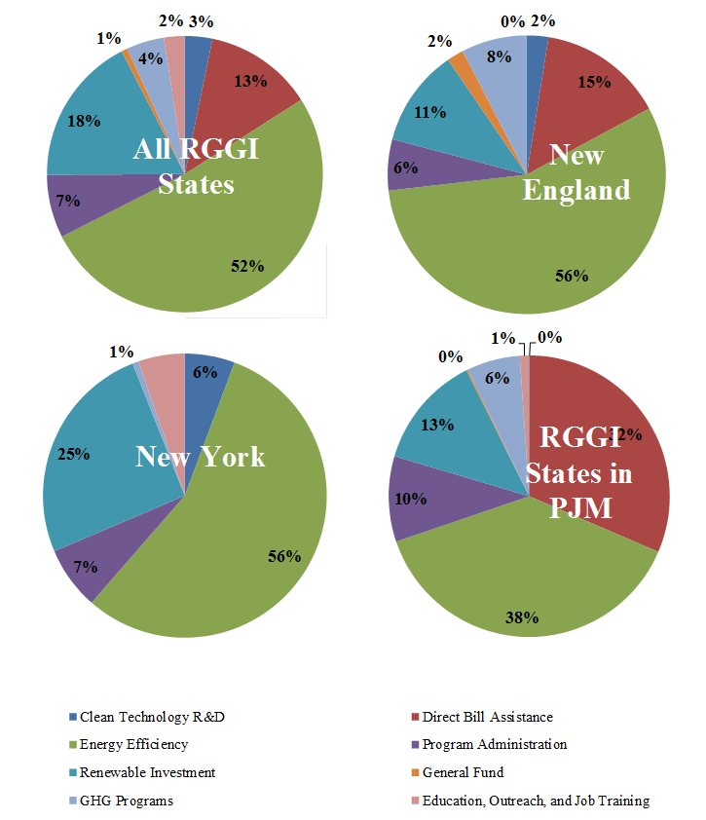
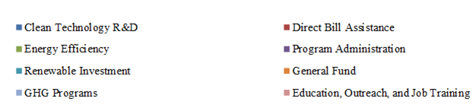
Summary of RGGI Proceed Spending
Compliance Period III
Source: Analysis of state-level proceeds spending data reported to RGGI, Inc.

Slide 13
Economic Impacts

Slide 14
Overall economic impacts – 9 states
Compliance Period III
The First Nine Years
(Compliance Periods I-III)
$1.4 billion (NPV) economic value added
$0.9 billion in auction proceeds used by states
14,000 new jobs
(in job-years)
Almost $600M in increased revenues to low/zero-carbon resources, Over $900M in revenue losses to CO2-emitting resources
Continued CO₂ emission reductions
$220 million reduction in energy bills
$4.7 billion (NPV) in economic value added
$2.8 billion in auction proceeds used by states
Over 40,000 new jobs (in job-years)
Over $1B in increased revenues to low/zero-carbon resources, Over $2B in revenue losses to CO₂-emitting resources
Drop in CO₂ emissions from sources by ~50%
Approximately $1B reduction in energy bills

Slide 15
Economic Impact of the Implementation of RGGI
Compliance Period III (NPV, 2018$)
Notes: [1] Figures are reported in 2018 dollars (NPV), converted using a 3-percent public discount rate. [2] Total economic value added reflects the impacts of state spending of RGGI proceeds, including net electric sector impacts to consumers and power plant owners, non-electric benefits, and the economic impact of program spending.

Slide 16
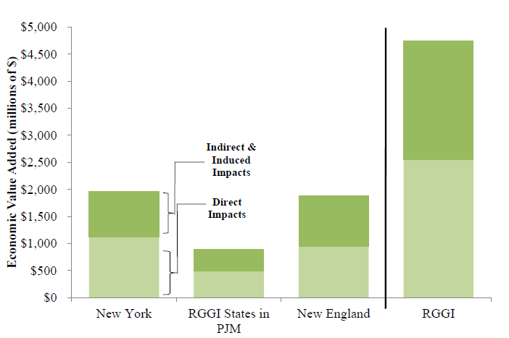
Economic Impact of the Implementation of RGGI
Since Inception – 2009 through 2017 (NPV, 2018$)
Notes: [1] Figures are reported in 2018 dollars (NPV), converted using a 3-percent public discount rate. [2] Total economic value added reflects the impacts of state spending of RGGI proceeds, including net electric sector impacts to consumers and power plant owners, non-electric benefits, and the economic impact of program spending.

Slide 17
Net Employment Impact to RGGI States
Compliance Period III (Cumulative Job Years)
Note: Figures represent employment in terms of cumulative job-years over the study period.

Slide 18
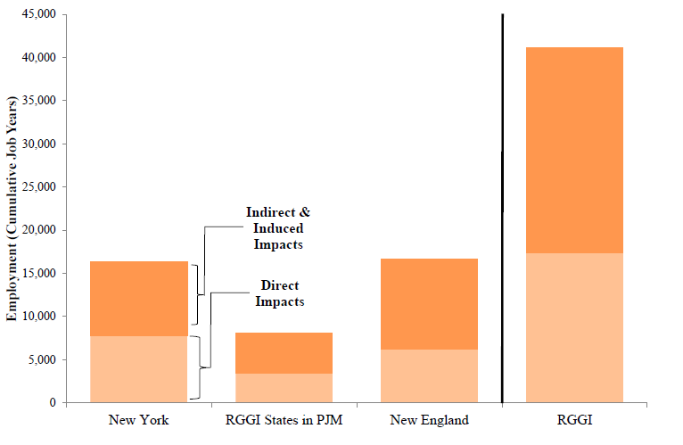
Net Employment Impact to RGGI States
Since Inception – 2009 through 2017 (Cumulative Job Years)
Note: Figures represent employment in terms of cumulative job-years over the study period.

Slide 19
Revenue Change to Power Plant Owners
By Power-Plant Fuel Type and Electrical Region
Compliance Period III (NPV, 2018$)
Notes: [1] Figures are reported in 2018 dollars (NPV), using a 3-percent public discount rate. [2] Figures include PROMOD outputs for energy prices and revenues and for capacity-market revenue changes that are calculated separately. [3] “Fossil” includes natural gas, oil, and coal-fired generators. “Non-fossil” includes nuclear, hydro, pumped storage, wind, solar, and biomass.

Slide 20
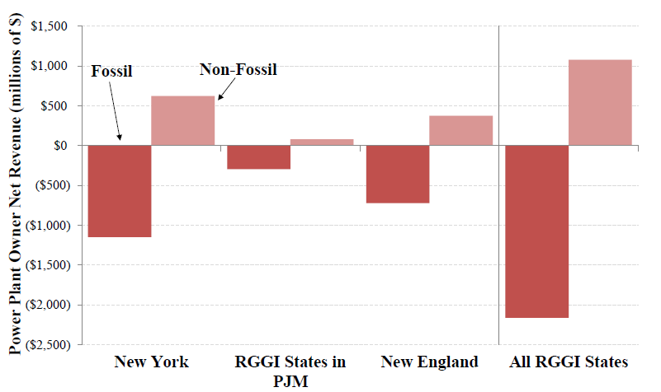
Revenue Change to Power Plant Owners
By Power-Plant Fuel Type and Electrical Region
Since Inception – 2009 through 2017 (NPV, 2018$)
Notes: [1] Figures are reported in 2018 dollars (NPV), using a 3-percent public discount rate. [2] Figures include PROMOD outputs for energy prices and revenues and for capacity-market revenue changes that are calculated separately. [3] “Fossil” includes natural gas, oil, and coal-fired generators. “Non-fossil” includes nuclear, hydro, pumped storage, wind, solar, and biomass.

Slide 21
Observations

Slide 22
Observations
  Mandatory, Market-Based Carbon Control Mechanisms are Functioning Properly and Can Deliver Positive Economic Benefits
  First mandatory market-based program has worked well over the past decade
  Emissions have declined (due to program and other factors)
  Program has integrated seamlessly in regional power markets
  States have collected and disbursed revenues consistent with state economic, energy and environmental policy goals
  States have worked cooperatively through a decade of major changes in both the RGGI program, and in the electric and economic context for the program
  Overall, the program has benefited the economies of member states, who realize approximately $1.4 billion in economic value added due to Compliance Period III implementation

Slide 23
Observations
  Positive job impacts with RGGI
  Results in thousands of jobs more than non-RGGI case
    14,500 “job-years”
    Reflects direct, indirect, induced jobs
    Some may be temporary, others longer term
    All associated only with first three years of program investments (but occur throughout the study period)
  Jobs spread around economy, e.g.
    Personnel doing energy efficiency audits
    Installers of energy efficiency measures or renewable projects
    Trainers, educators
    State workers whose responsibilities might otherwise be eliminated due to budget challenges

Slide 24
Observations
  RGGI Reduces the Region’s Payments for Out-of-State Fossil Fuels
  Reduced generation (due to lower consumption), and reduces payment for fuels - $1.37 billion less spent on fossil fuels from outside the region
  Represents additional funds that stay mostly within state economies
  Reductions in net revenues for fossil-fueled facilities during first 3 years (when carbon prices are incurred), and overall across the forecast period
  Increase in net revenues for all non fossil-fueled resources
  Net effect is reduced revenues for power plants as a whole over modeling period

Slide 25
Observations
  The Design of the CO2 Market in the RGGI States Affected the Size, Character, and Distribution of Public Benefits
  Decision by RGGI states to auction allowances transfers emission rights from public to private sector at a monetary cost
  Retains value of allowances – and generates substantial revenue – for public use
  Prevents transfer of that value to power plant owners
  Price impacts on electric markets the same either way
  Effect of economy, consumption, and fuel prices relative to original cap affected allowance prices and ultimate revenues for public use

Slide 26
Observations
  How Allowance Proceeds Are Used Affects Their Economic Impacts
  States used funds in different ways, providing a wide variety of public benefits not captured in economic analysis
    This does not decrease the value of different investment vehicles
  However, how funds are used does affect economic impact
    Energy efficiency investments have strongest positive economic impact
      Reduces consumption (particularly for participants)
      Depresses wholesale prices (for all)
      Keeps impacts largely within electric sector
    Other investments have strong returns, transferring value to other sectors of the economy
      Direct bill assistance
      General fund contributions
      Education and job training

Slide 27
Observations
  A decade of RGGI program implementation provides a wealth of information for states seeking carbon reductions
  The program’s main goal is carbon control and climate risk mitigation; yet the program allows for the accrual of economic benefits through an efficient market-based structure
  RGGI has worked as a multi-state program with a common market and auction platform – the door is open for other states that may seek to control CO₂ emissions in a way that captures the lower costs and increased efficiency of a common, multi-state program
  The RGGI model fully preserves states interests and authorities, and allows states to achieve carbon reductions in a manner consistent with state policy objectives
  The RGGI program can work seamlessly in both competitive market and vertically-integrated regulated utility contexts

Slide 28
Contact
Paul Hibbard, Principal
617-425-8171
phibbard@analyisgroup.com

